Slide 1
My Power Point
By Michael A. Conduff

Slide 2
Kobe Yoder
This is my best friend Kobe. It’s a little fuzzy but this is him.

Slide 3
My favorite movie is Nightmare on Elm St.
It’s a horror movie. Little kids may not want to see this movie until there older.

Slide 4
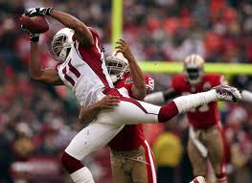
Larry Fitzgerald
I AM A ARIZONA CARDINALS FAN!!!!!!!!!!!!!!!!!!!!!!!!!!!!!!!!!!!!!!!!!!!!!!!!!!!!!!!!!!!!!!!!!!!!!!!!!!!!!!!!!!!!!!!!!!!!!!!!!!!!!!!!!!!!!!!!!!!!!!!!!!!!!!!!!!!!!!!!!!!!!!!!!!!!!!!!!!!!!!!!!!!!!!!!!!!!!!!!!!!!!!!!!!!!!!!!!!!!!!!!!!!!!!!!!!!!!!!!!!!!!!

Slide 5
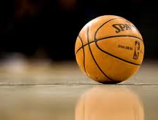
Basketball
My Favorite Sport Is Basketball!

